Slide 1

Praram 9 Hospital Bangkok
DS 532 Text Analysis

Slide 2
Step by Step
Import Utilities
Read data
Sentence Tokenize
Sentence-level sentiment
Parsing
Extract Noun Phrase
Put Information into DataFrame
Split dataframe into positive and negative sentiment
Word Cloud Representation

Slide 3
Step by Step
Plot Rader Chart
Extracting Feature from Cleaned comment
Splitting our dataset into Training and Validation Set
Applying Machine Learning Models
Model Comparison
Evaluating the model
Comparison Graph
Playing around with auto-Sklearn

Slide 4
Import Utilities
Library Installation
!pip install googletrans
!pip install tqdm --upgrade
!pip install twython

Slide 5
Import Utilities
Import Library
web scraping
import requests
from bs4 import BeautifulSoup
from time import time, sleep
from random import randint
Translation
from googletrans import Translator
Utilities
from tqdm import tqdm
from tqdm import tqdm_notebook
import numpy as np
import pandas as pd
NLP
from nltk import sent_tokenize, word_tokenize, pos_tag, RegexpParser
from nltk.sentiment.vader import SentimentIntensityAnalyzer
from nltk.sentiment.util import mark_negation

Slide 6
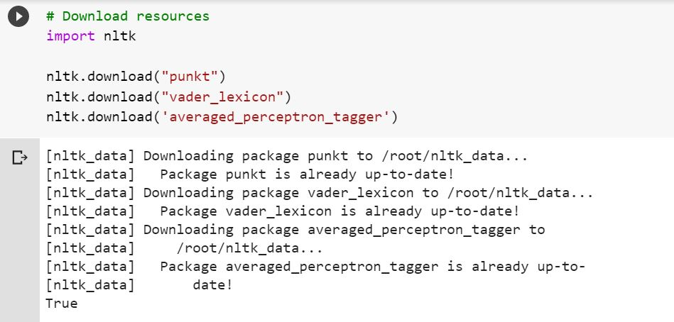
Import Utilities
Download resources
import nltk
nltk.download("punkt")
nltk.download("vader_lexicon")
nltk.download('averaged_perceptron_tagger')

Slide 7
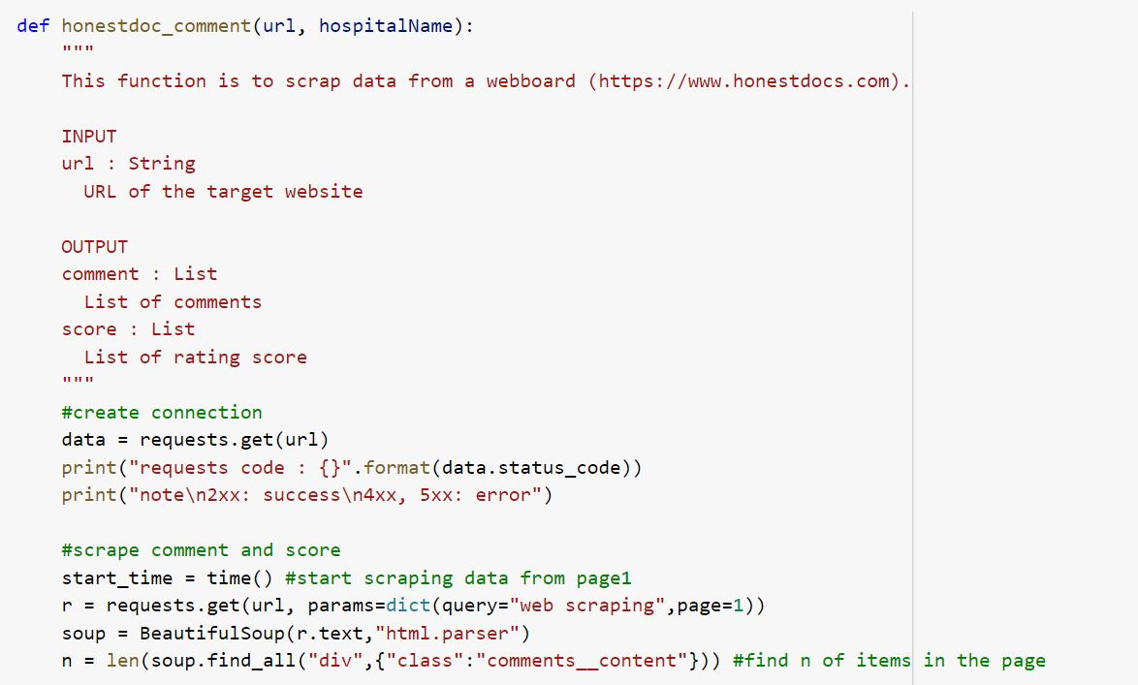
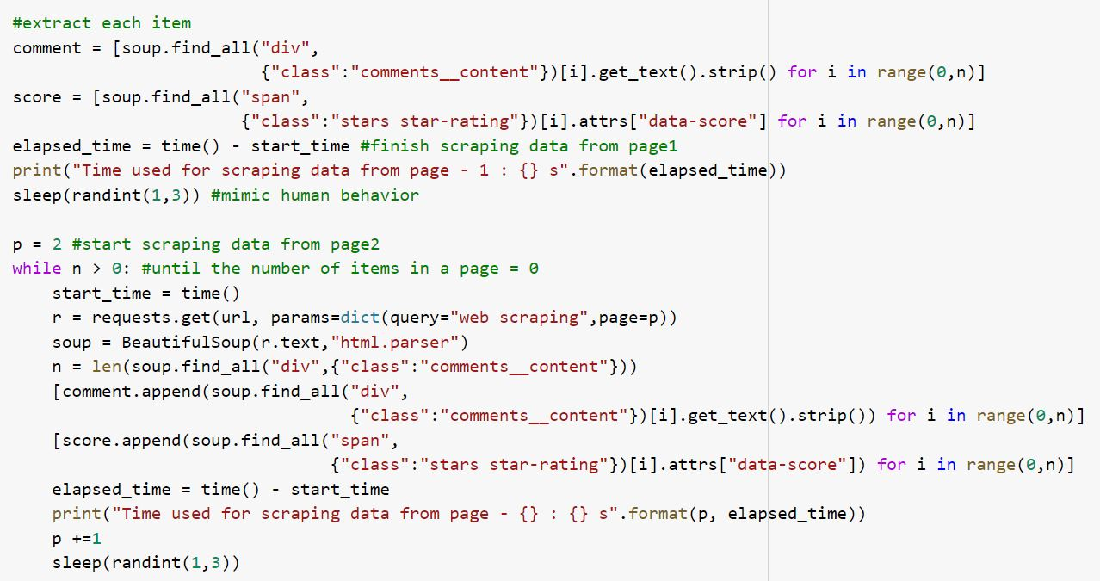
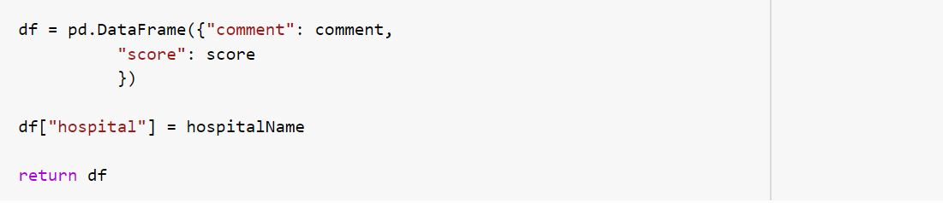
Import Utilities
Web Scraping
ดึงข้อมูลความเห็นจากผู้ที่มาใช้บริการโรงพยาบาล โดยสร้าง data frame

Slide 8
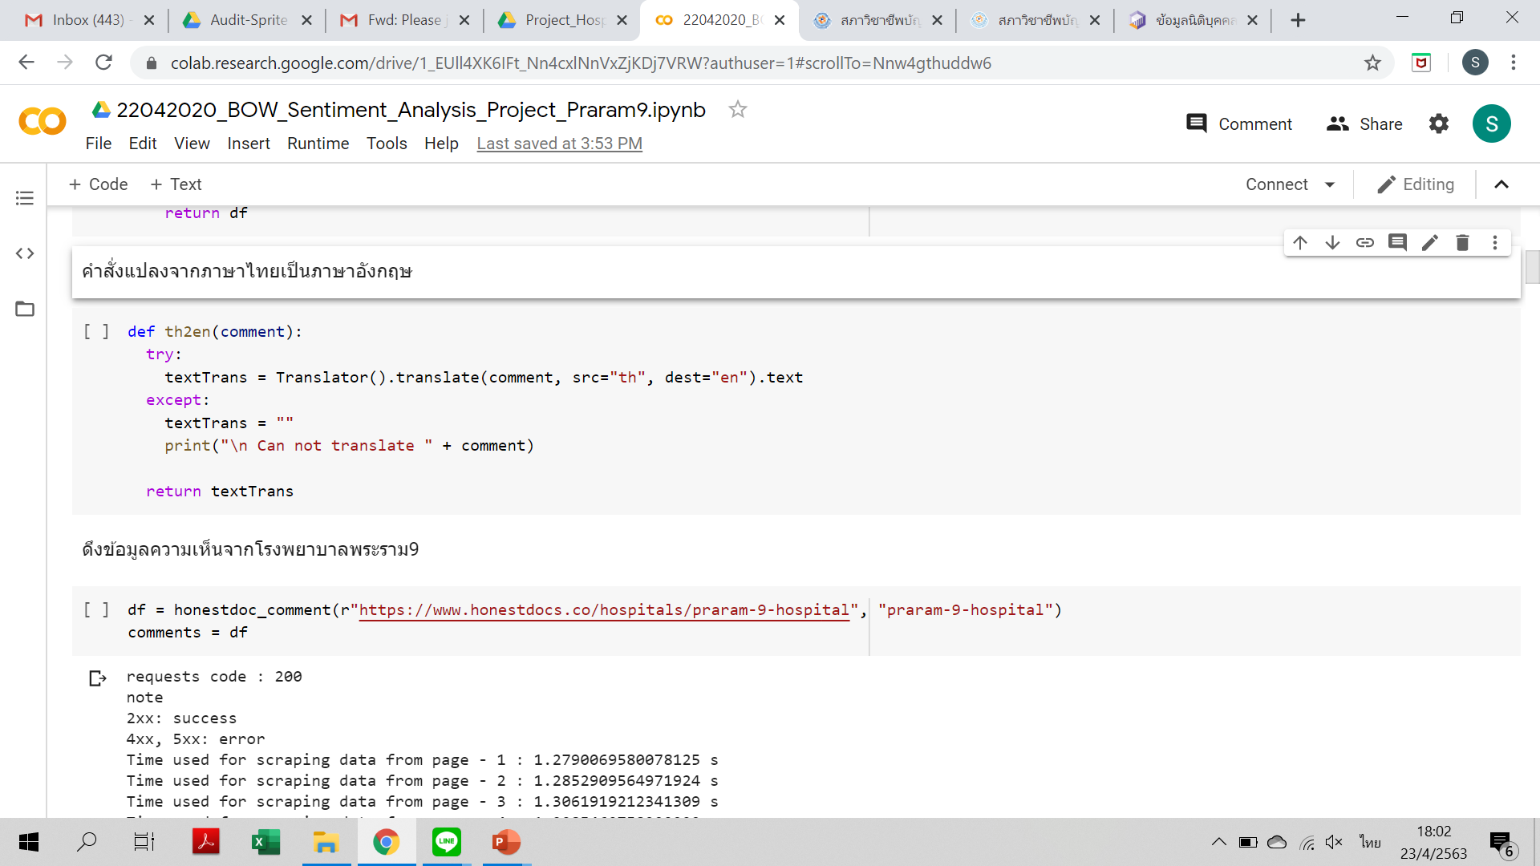
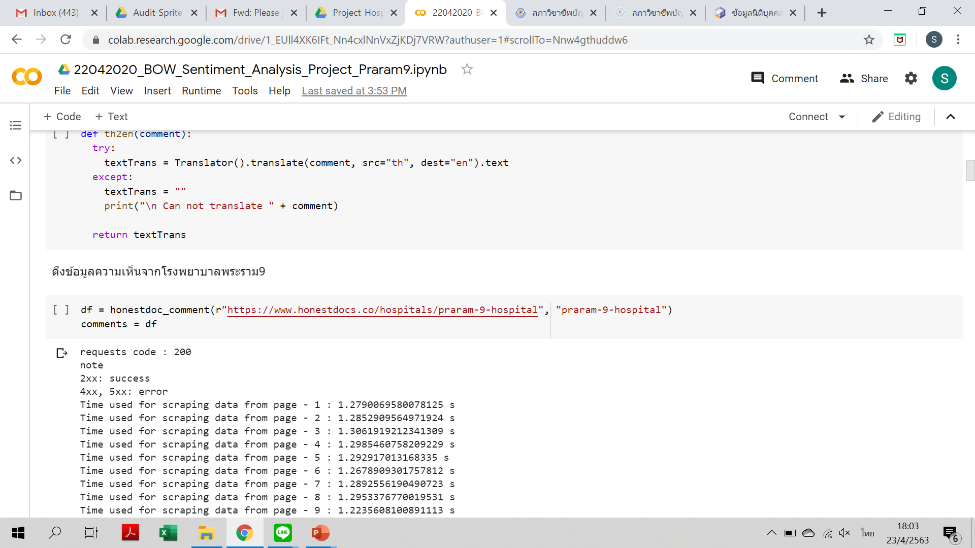
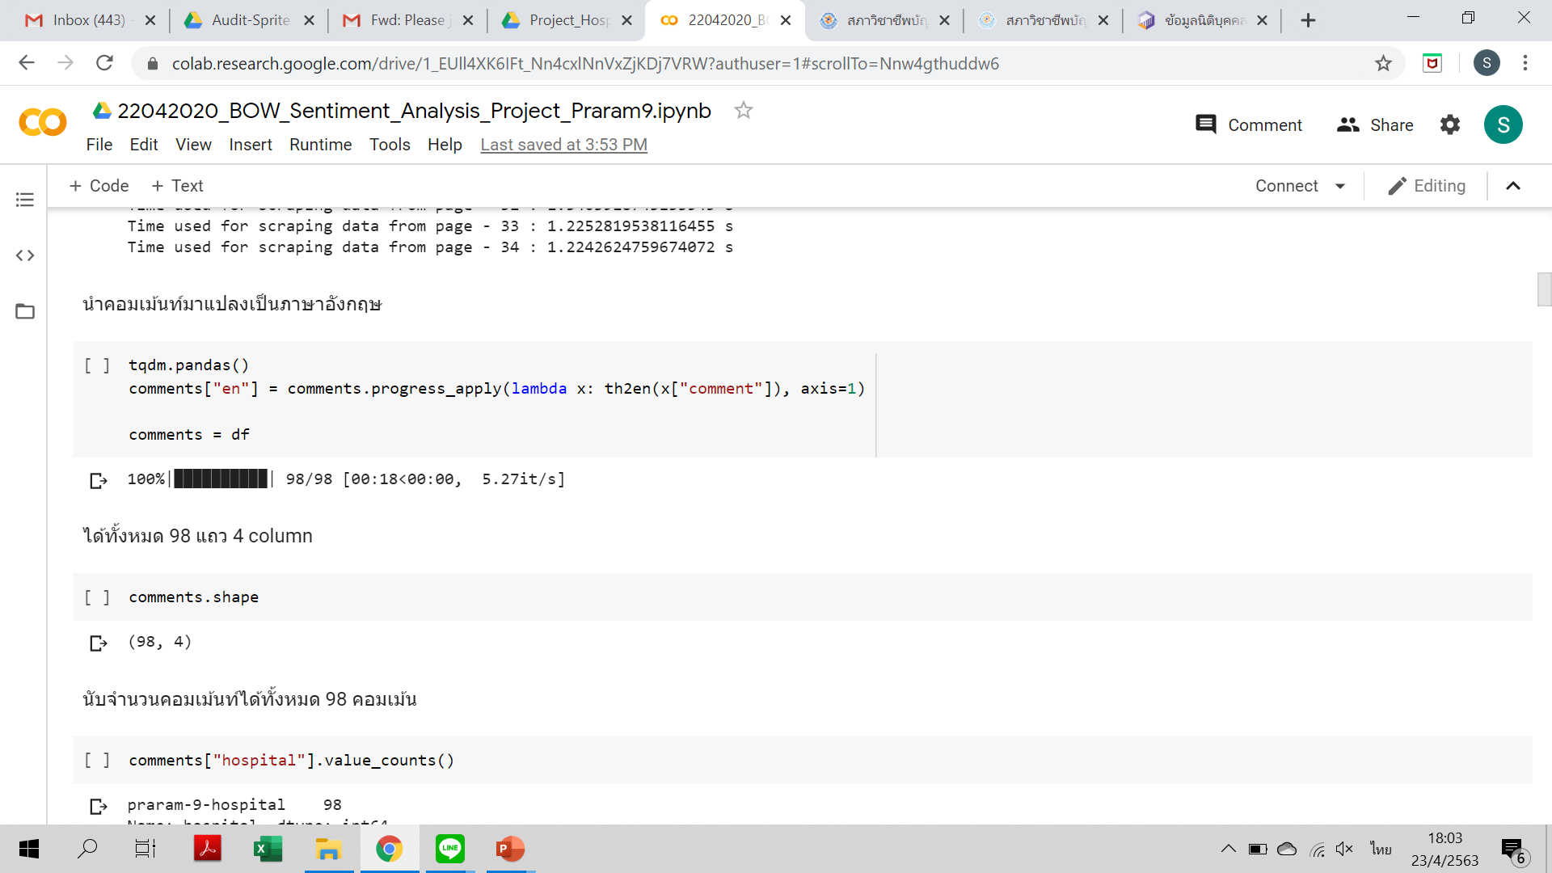
Import Utilities

Slide 9
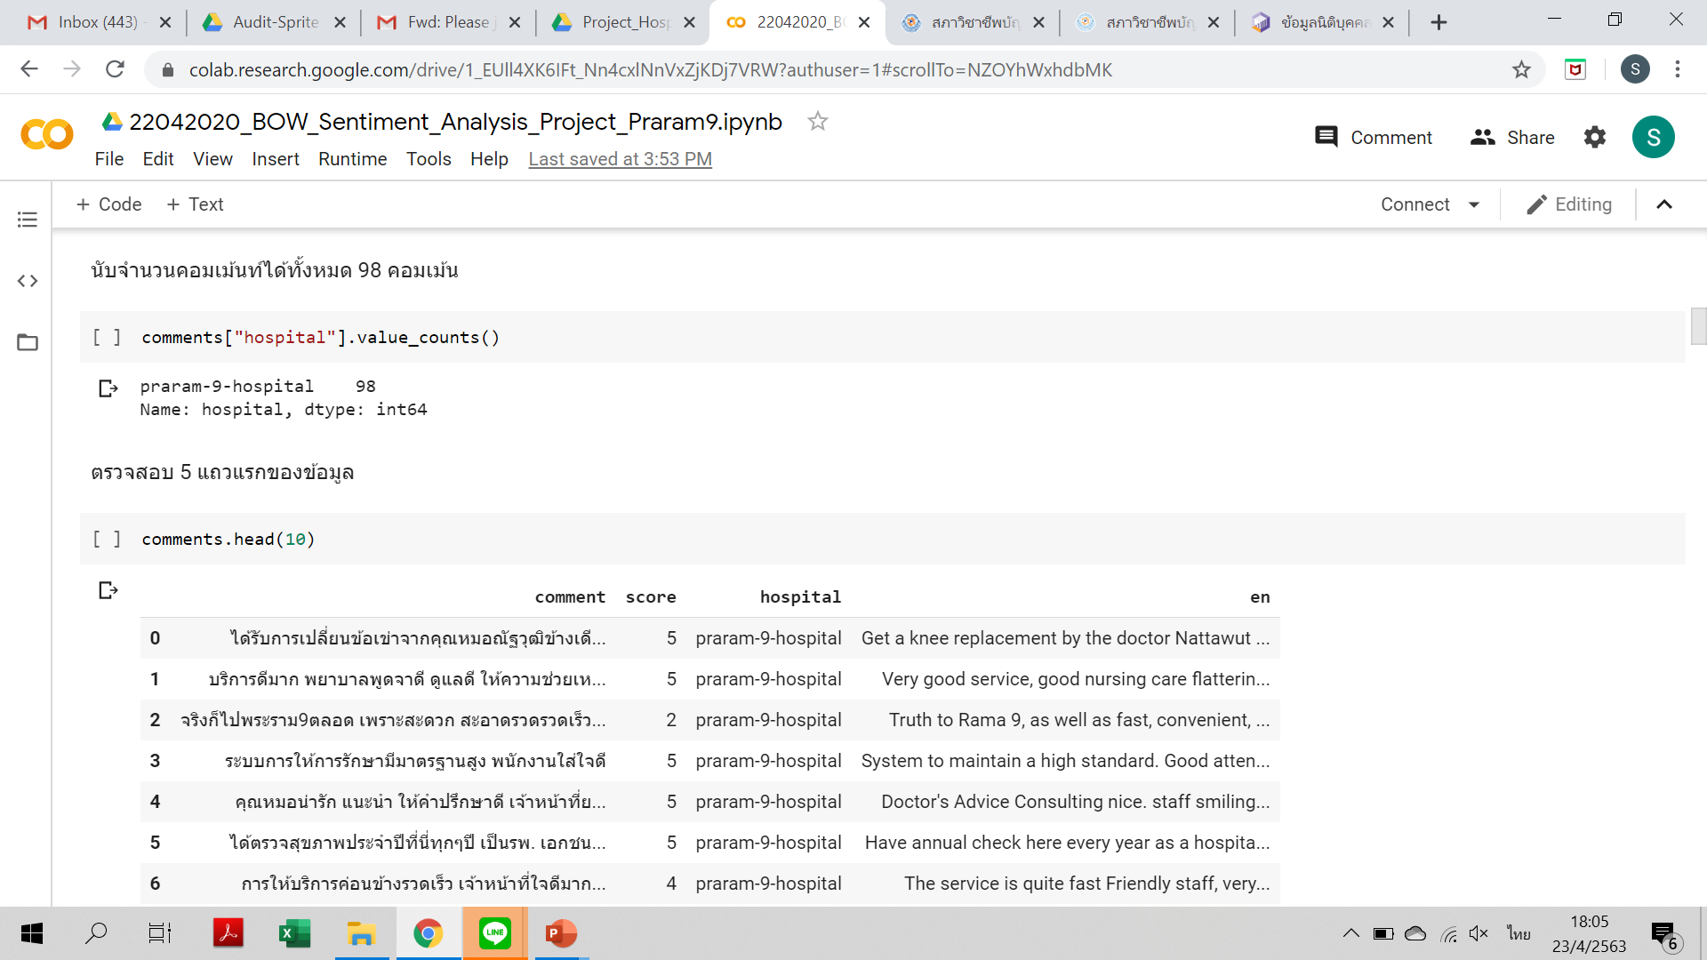
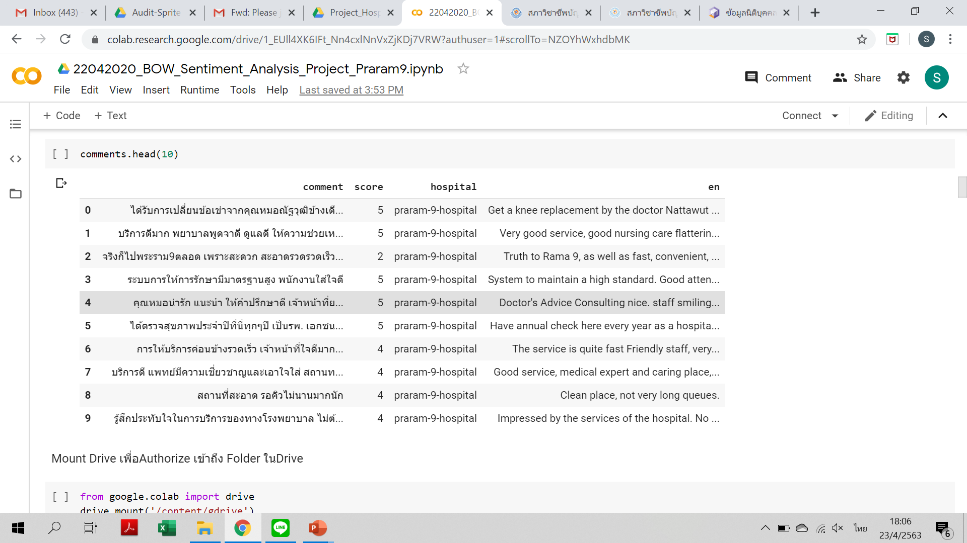
Import Utilities

Slide 10
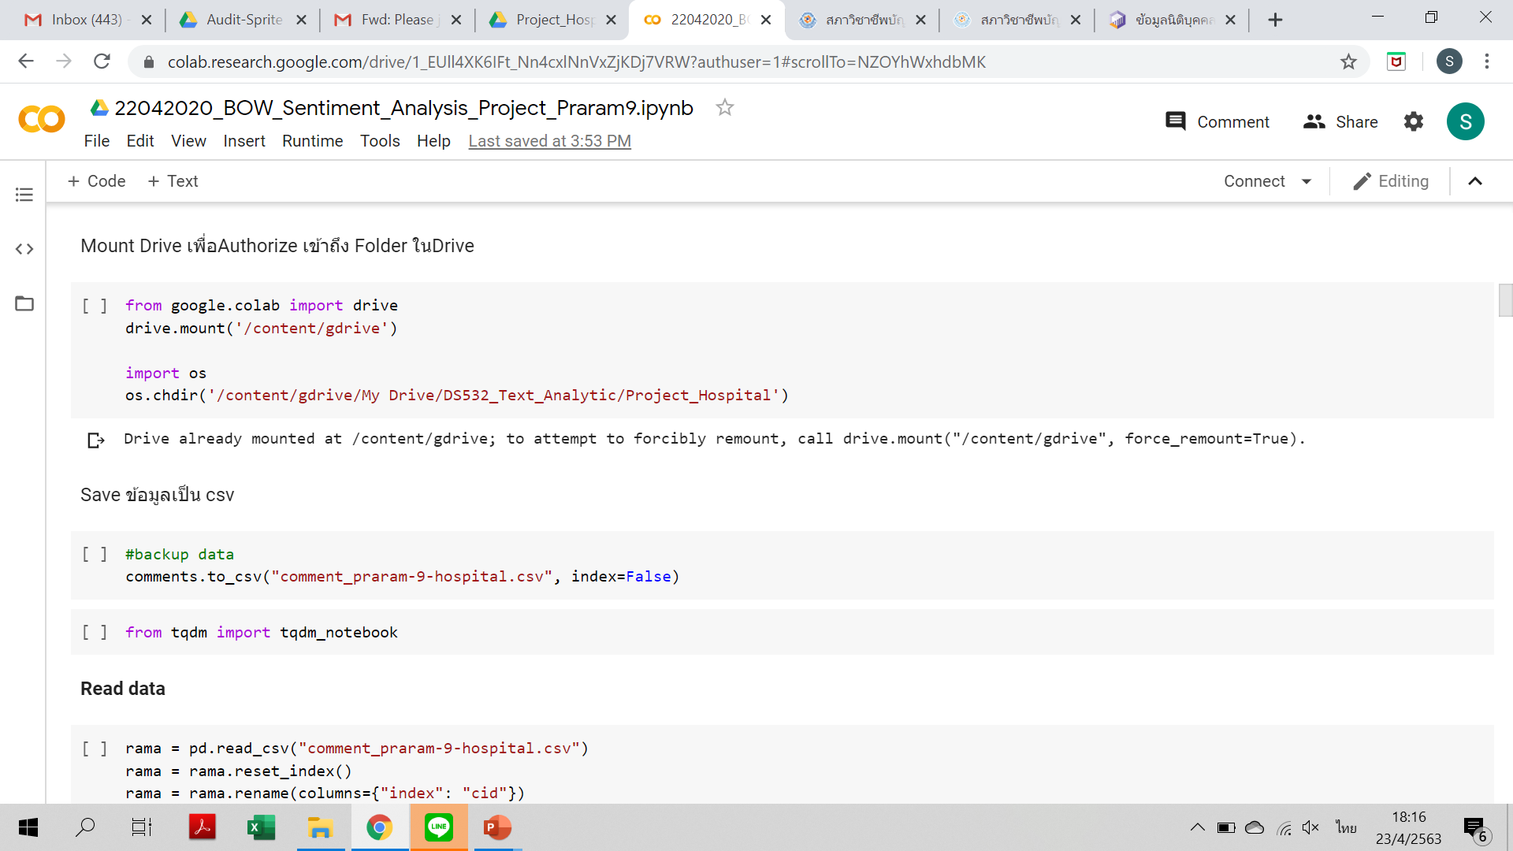
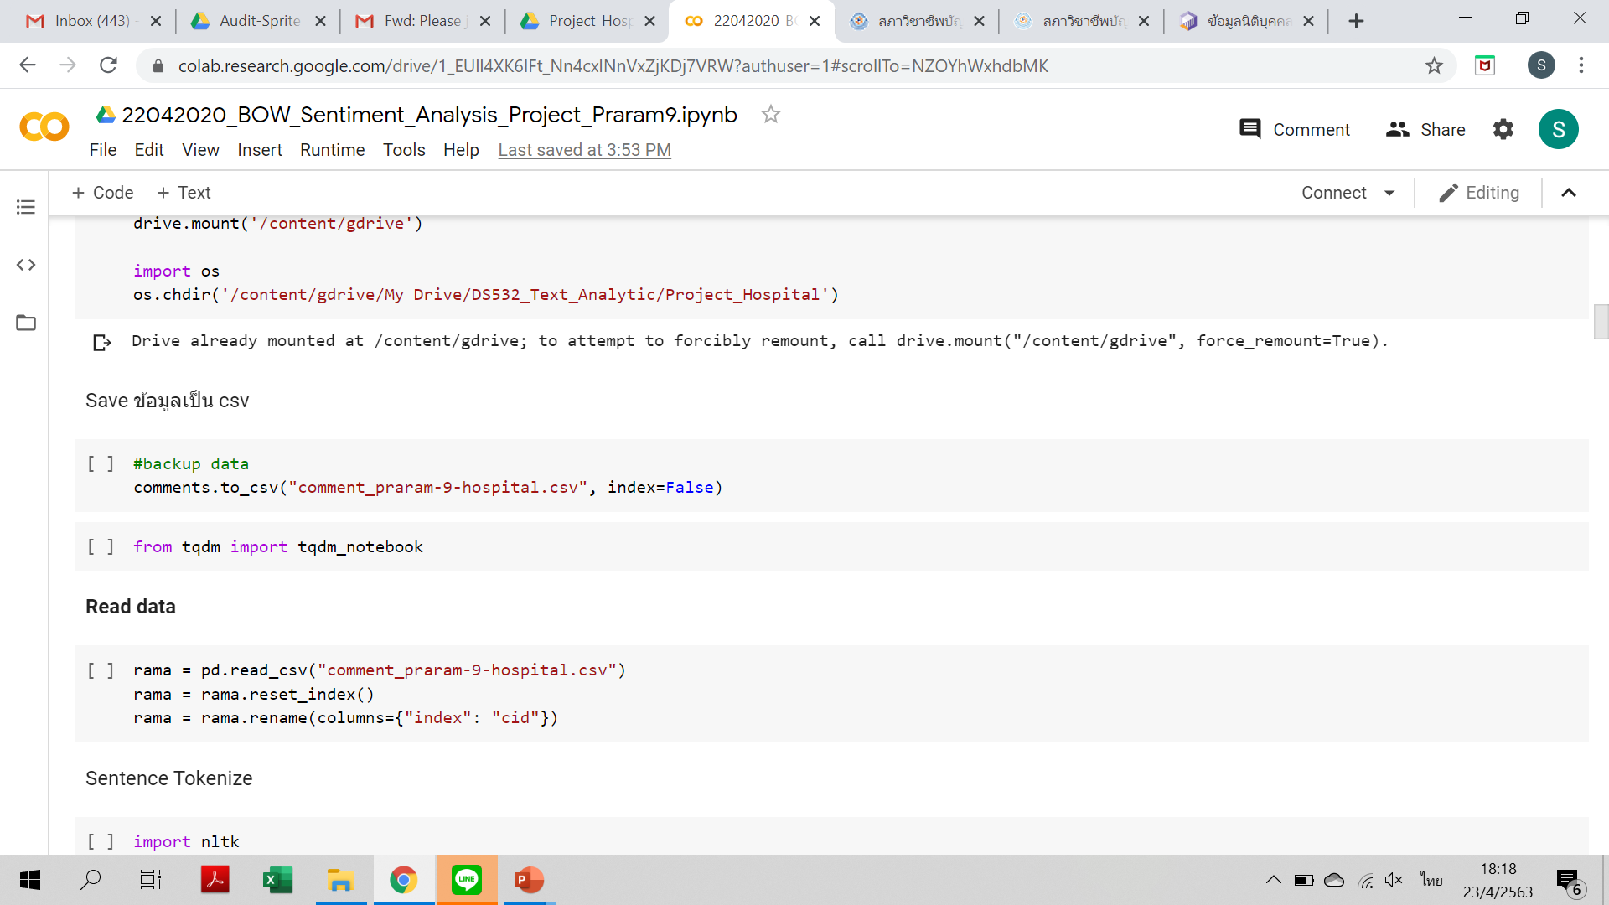
Import Utilities

Slide 11
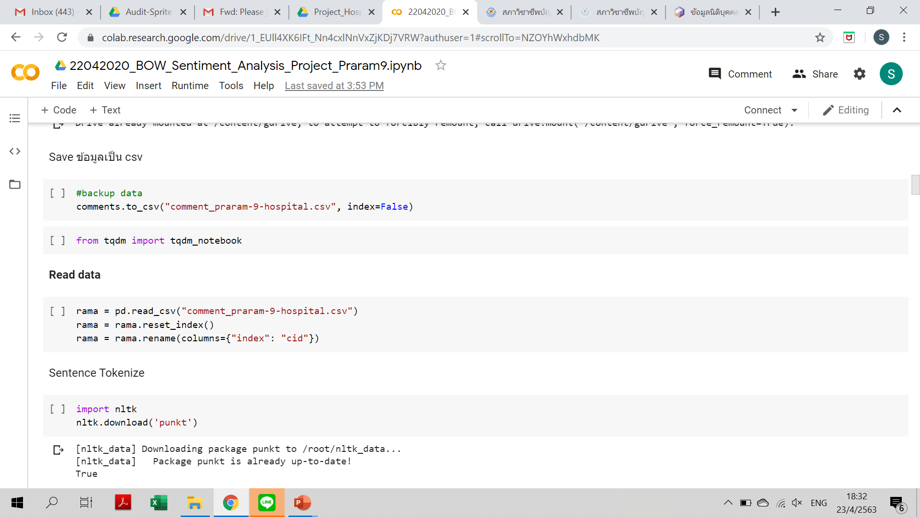
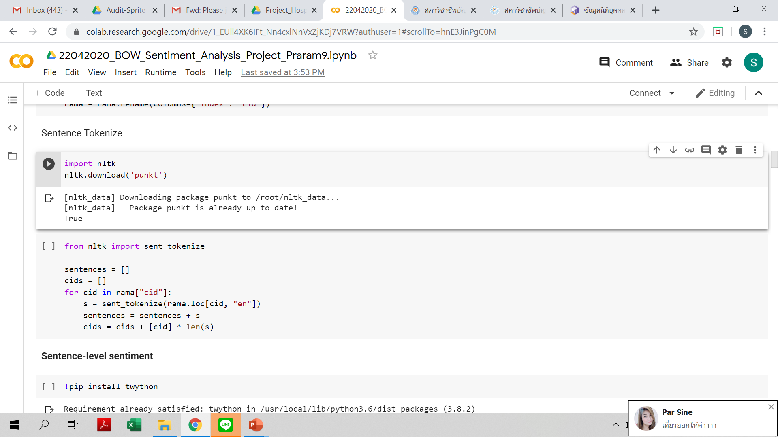
Read Data
Sentence Tokenize

Slide 12
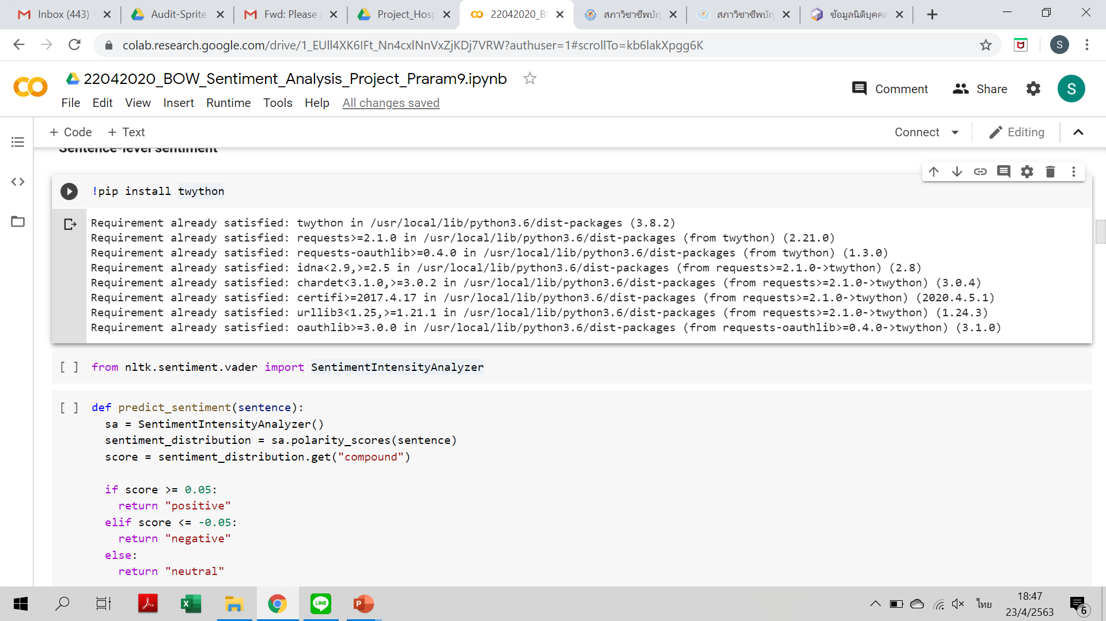
Sentence-level sentiment

Slide 13
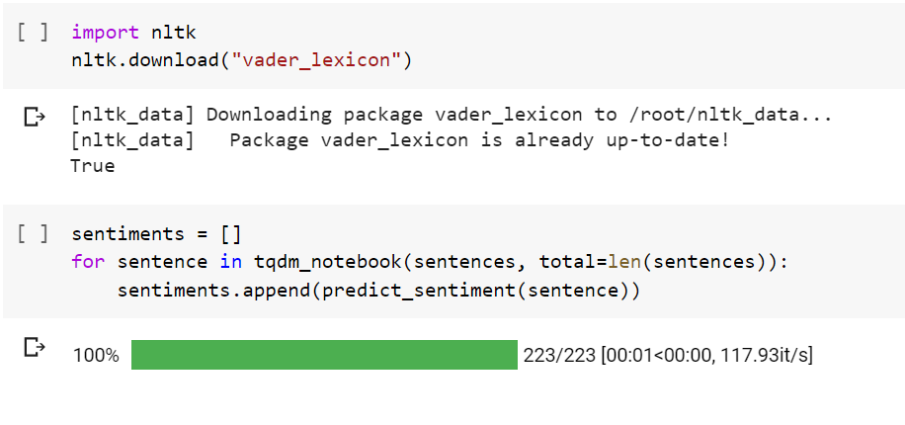
Sentence-level sentiment

Slide 14
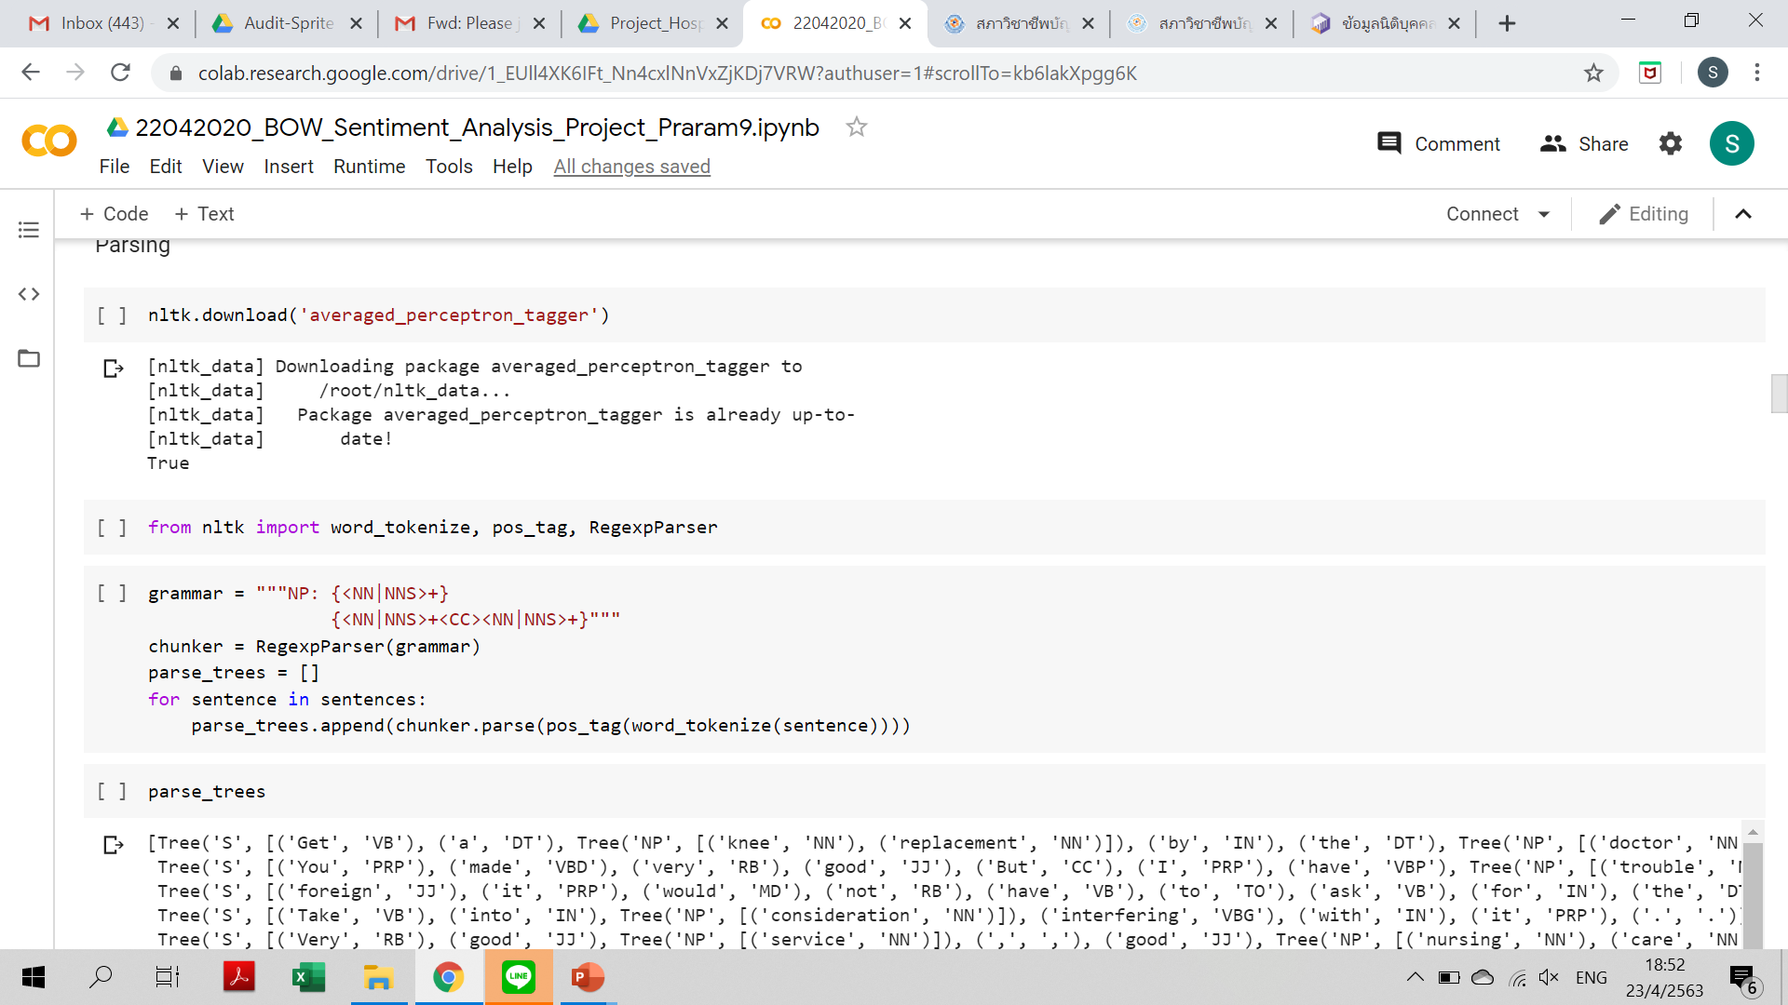
Parse

Slide 15
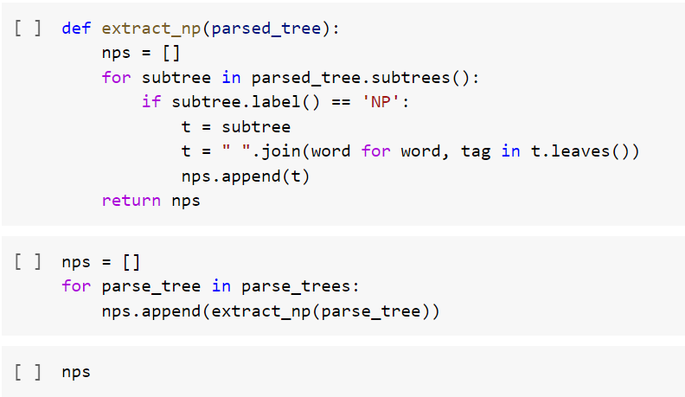
Extract Noun Phrase

Slide 16
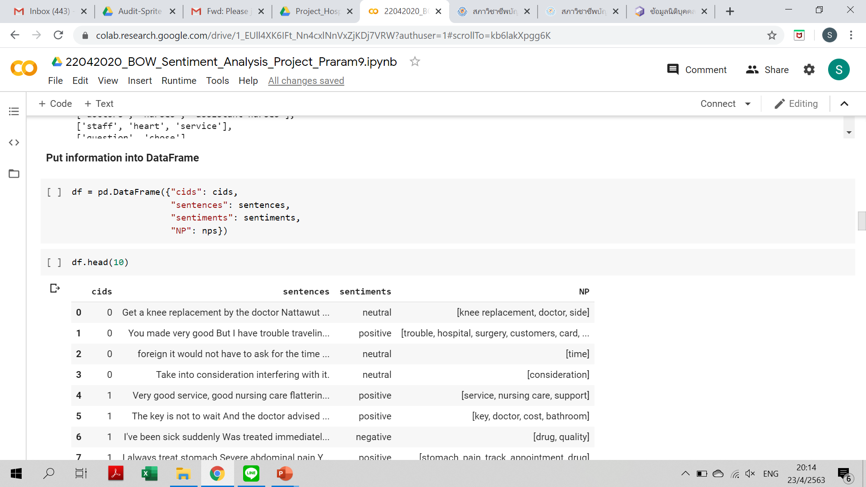
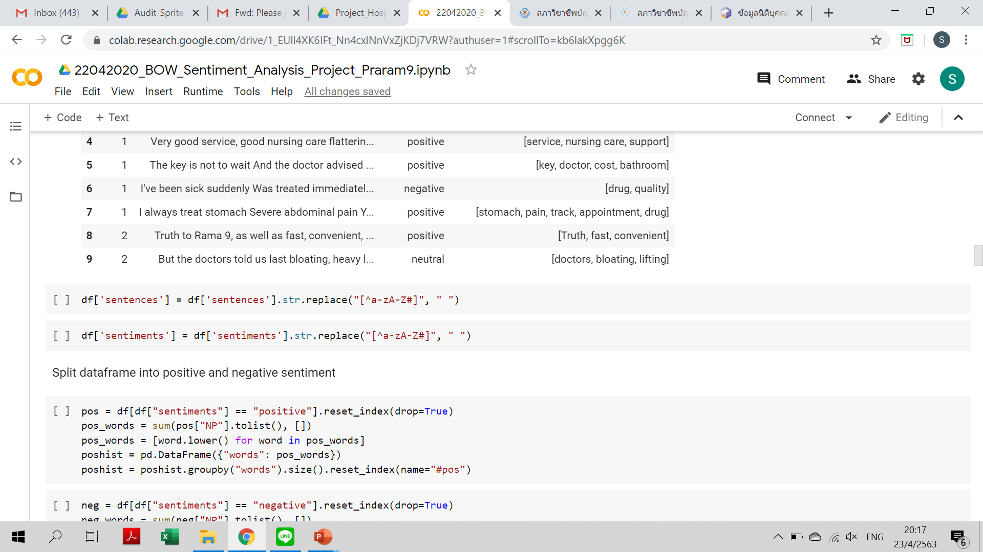
Put Information into DataFrame

Slide 17
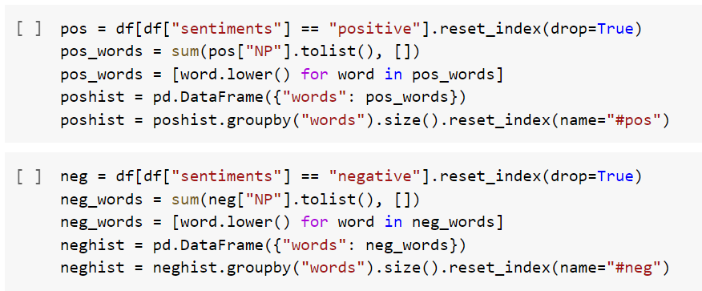
Split dataframe into positive and negative sentiment

Slide 18
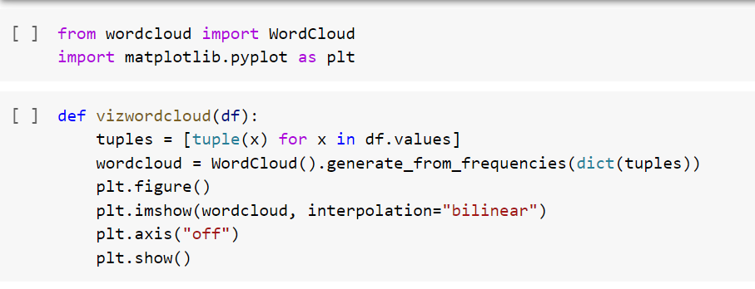
Word Cloud Representation

Slide 19
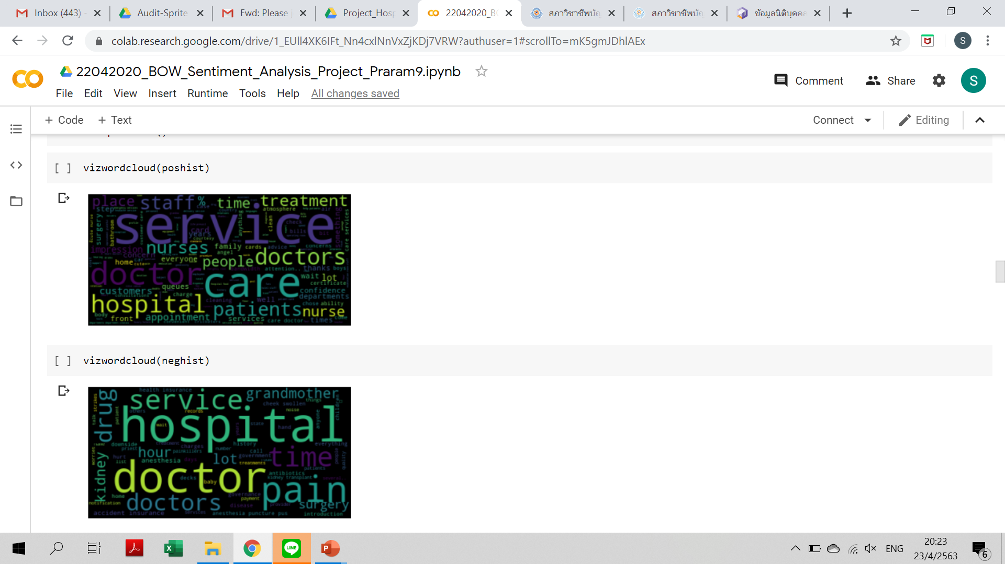
Word Cloud Representation

Slide 20
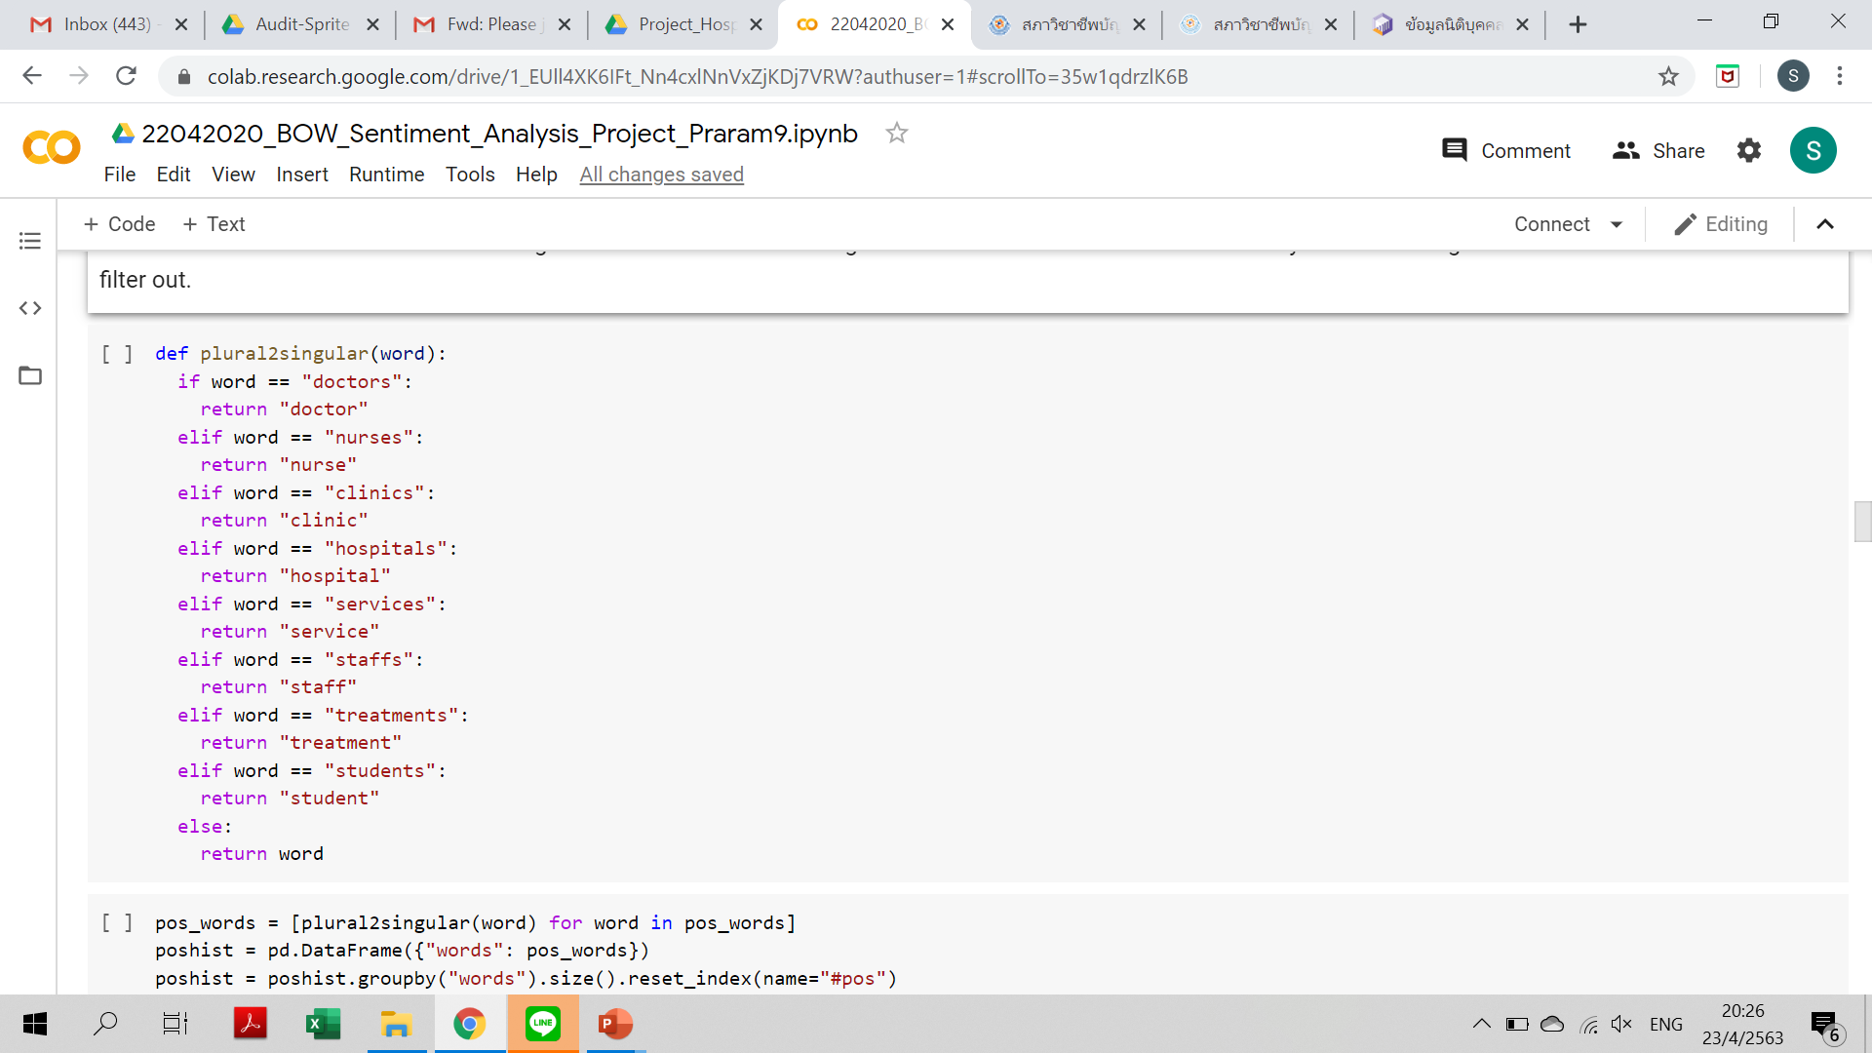
Word Cloud Representation
We saw 2 problems: 1) Singular and plural words were not combined and 2) words that should not be appeared in the wordcloud such as patients because of the co-reference resolution problem.
Let's transfrom selected words to their singular form because at this stage the number of words is not much already then add categories to filter out.

Slide 21
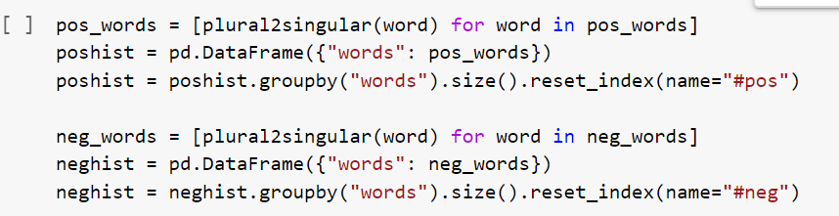
Word Cloud Representation

Slide 22
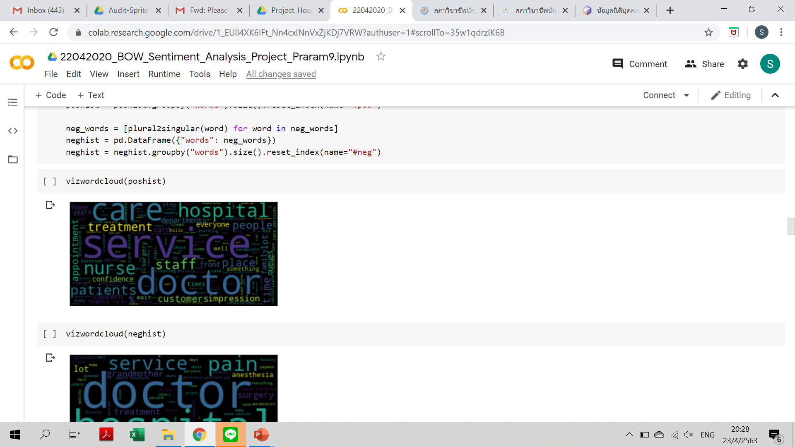
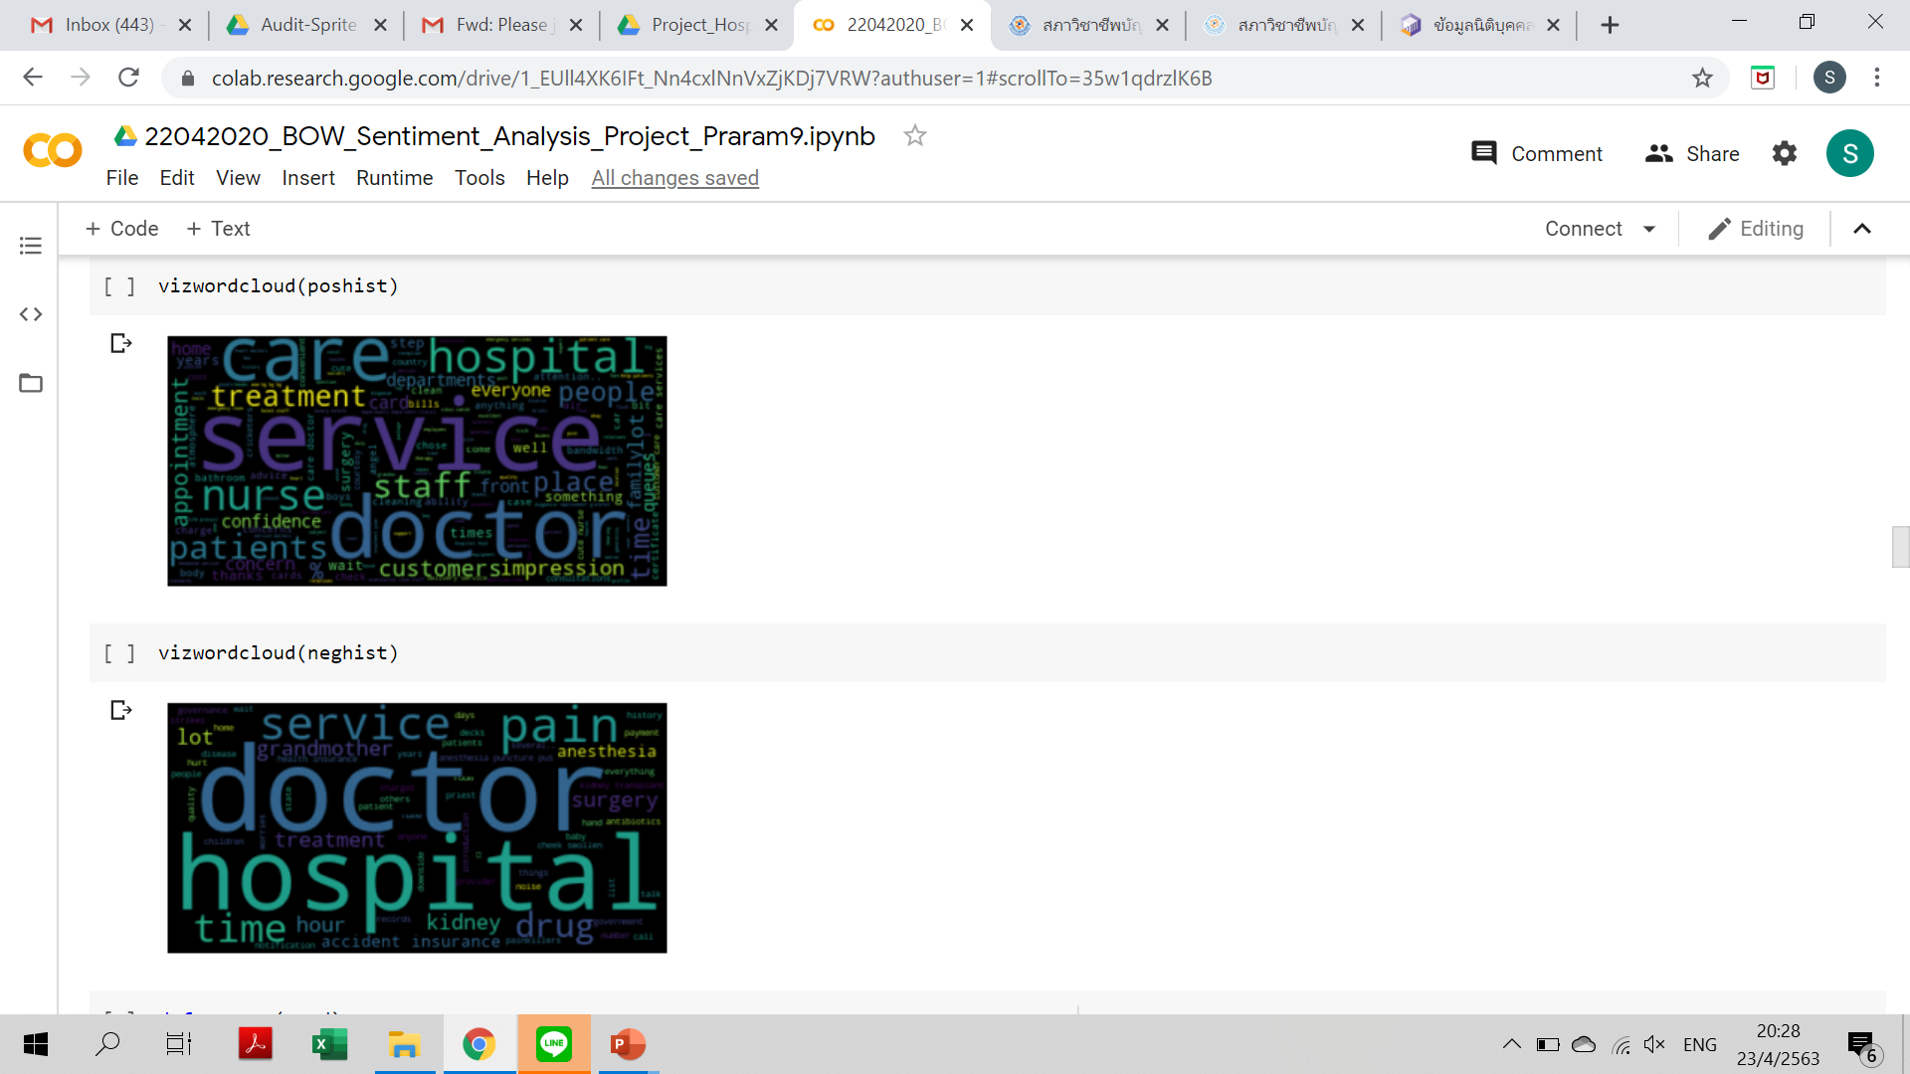
Word Cloud Representation

Slide 23
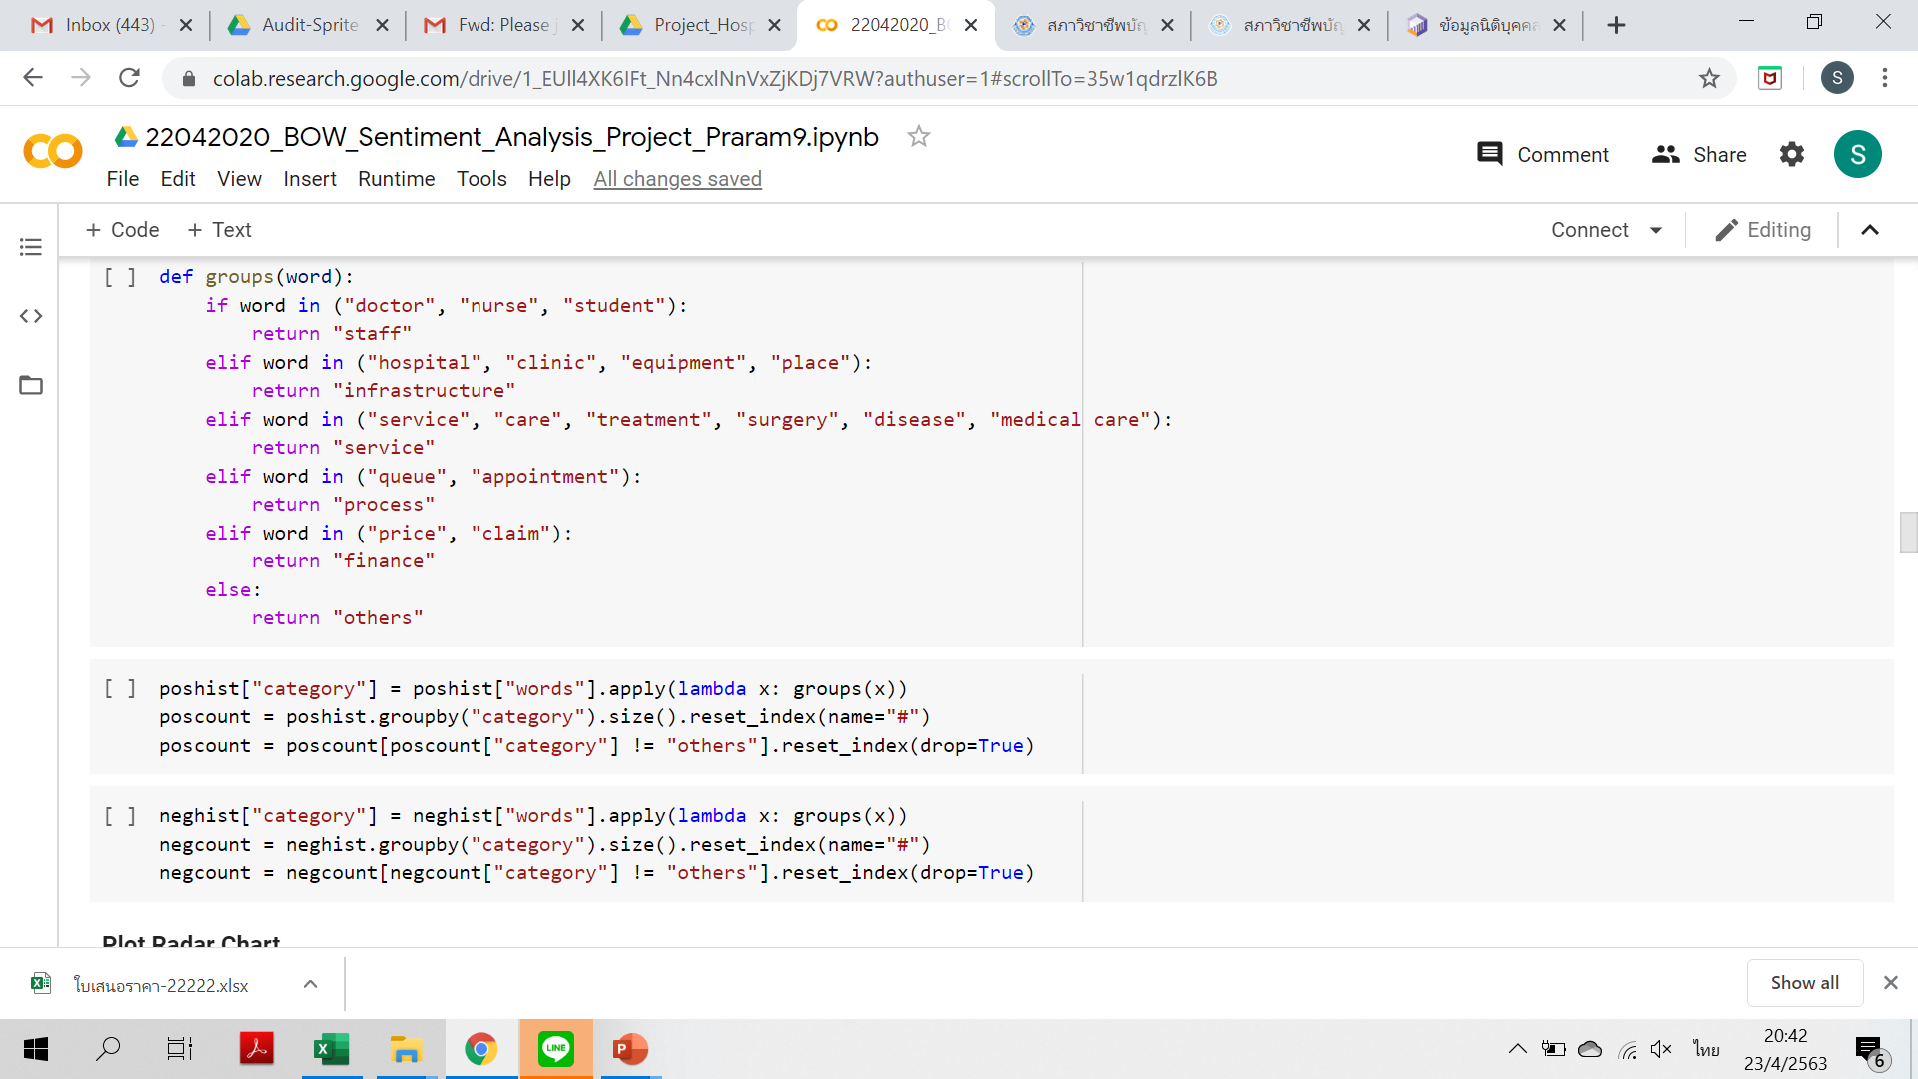
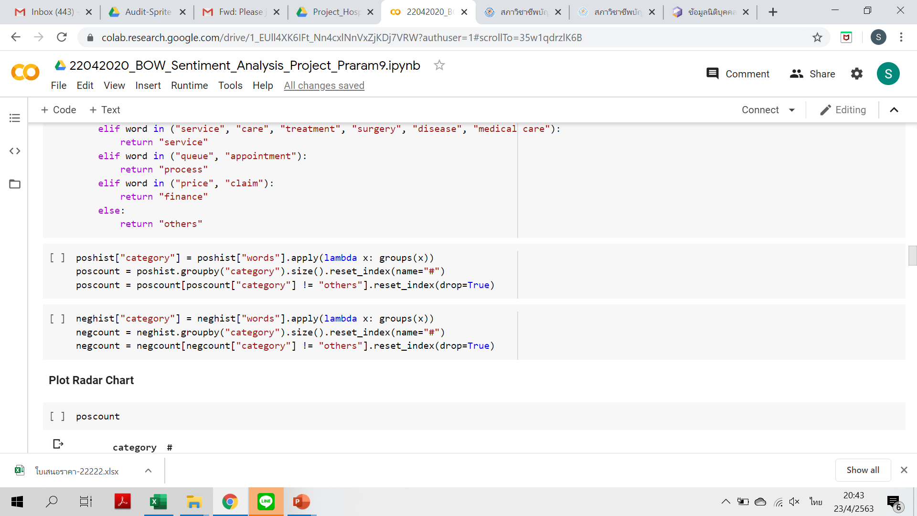
Word Cloud Representation

Slide 24
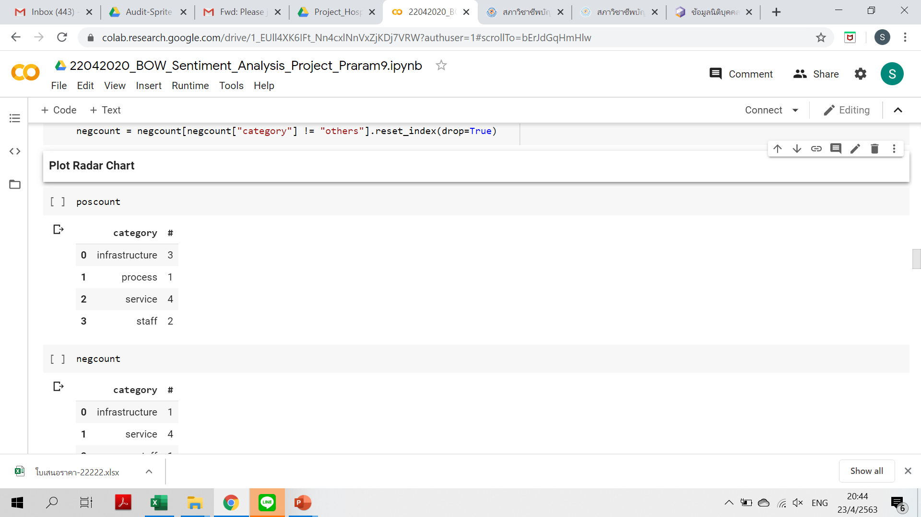
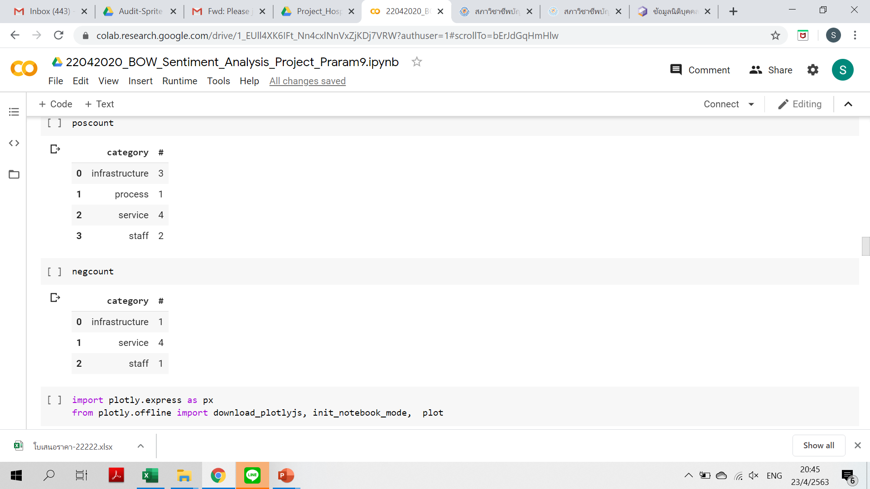
Plot Radar Chart

Slide 25
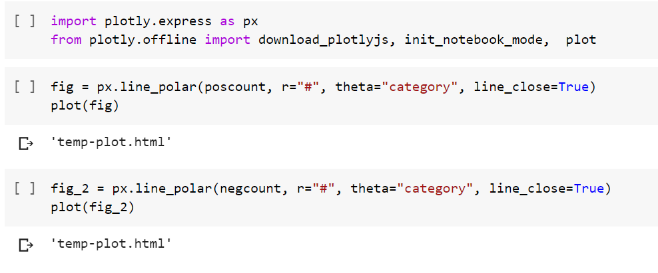
Plot Radar Chart

Slide 26
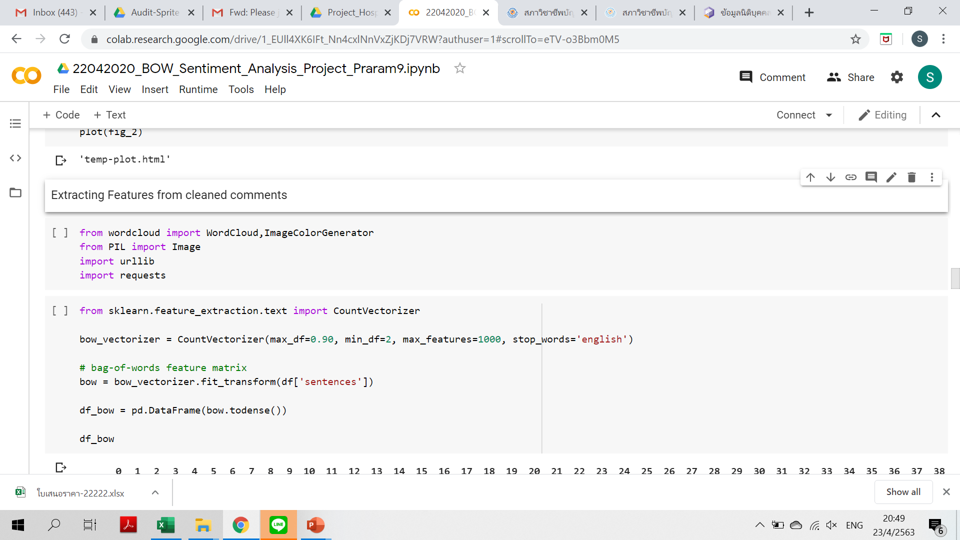

Extracting Features from cleaned comments

Slide 27
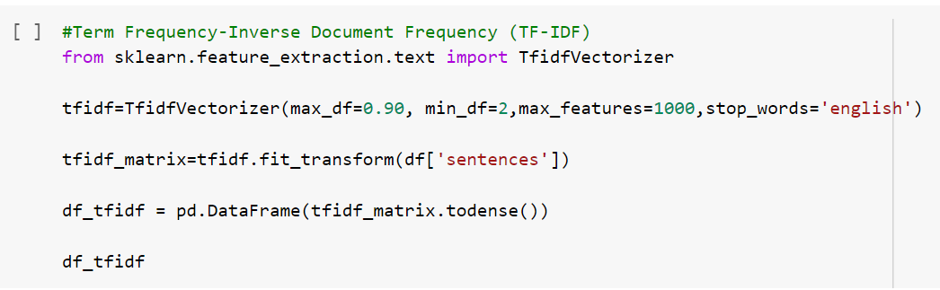
Extracting Features from cleaned comments

Slide 28
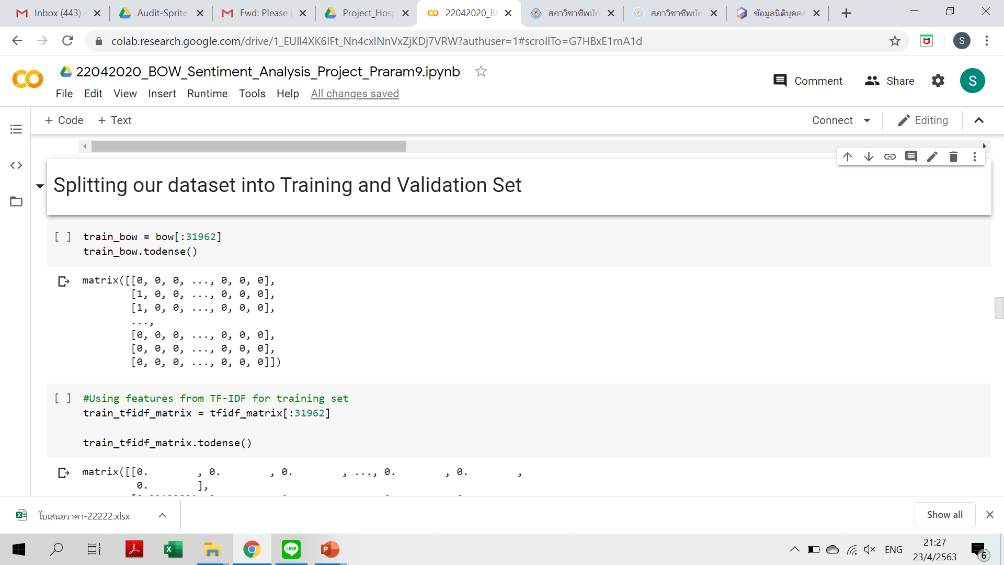
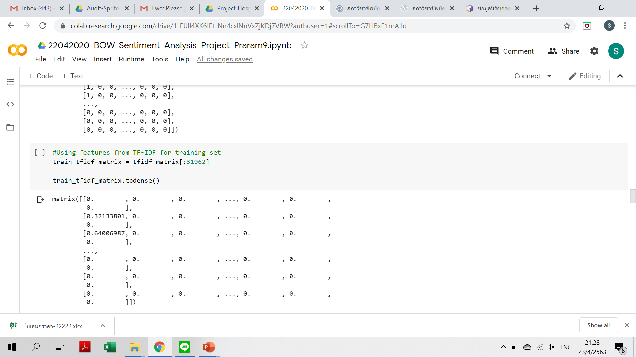
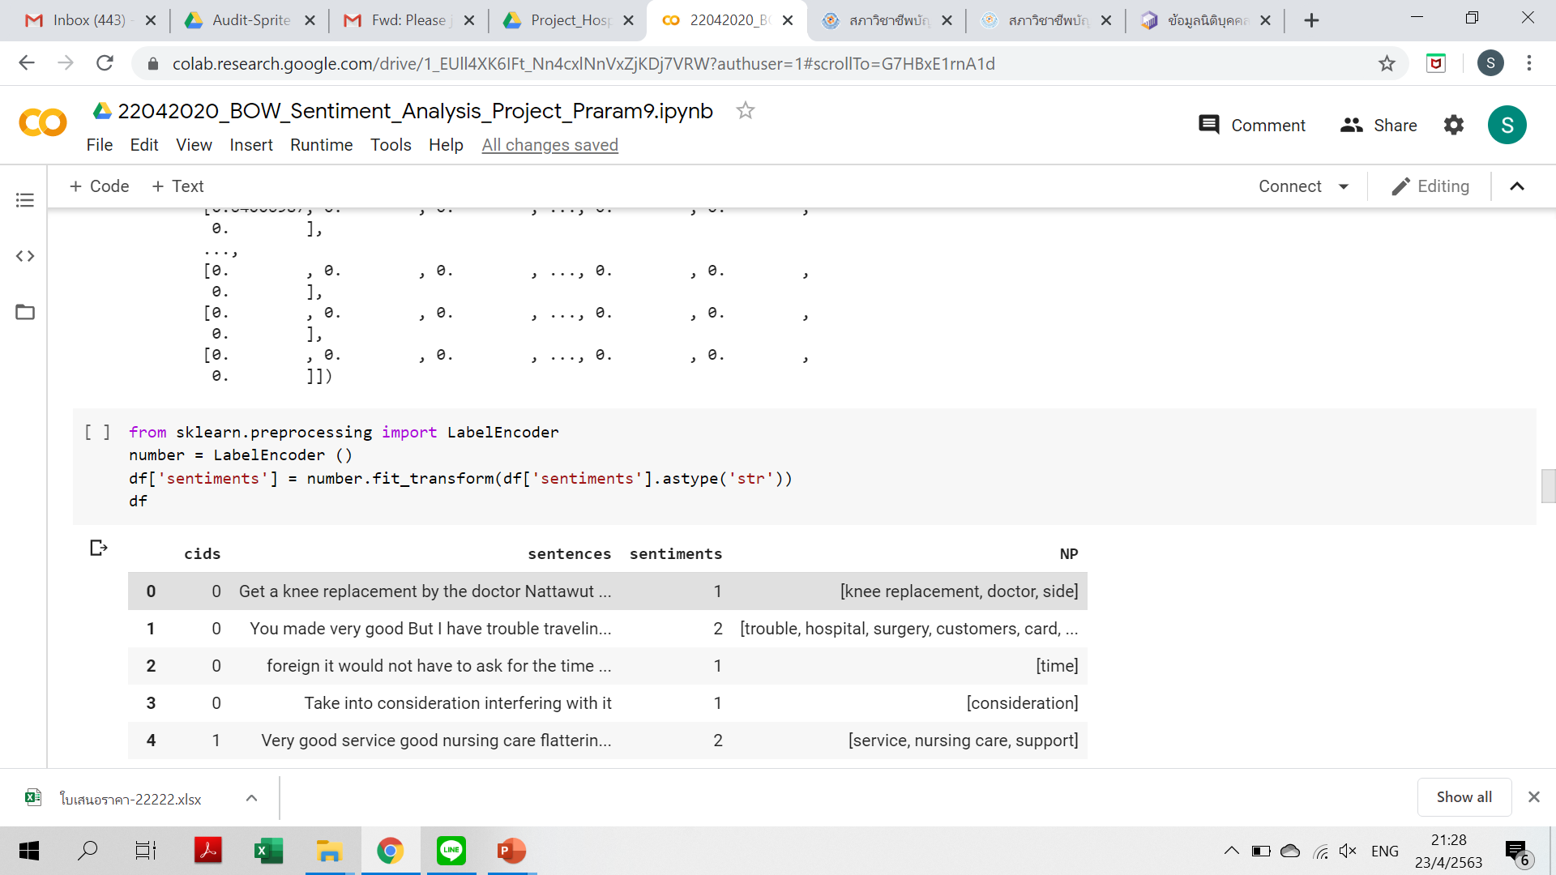
Splitting our dataset into Training and Validation Set

Slide 29
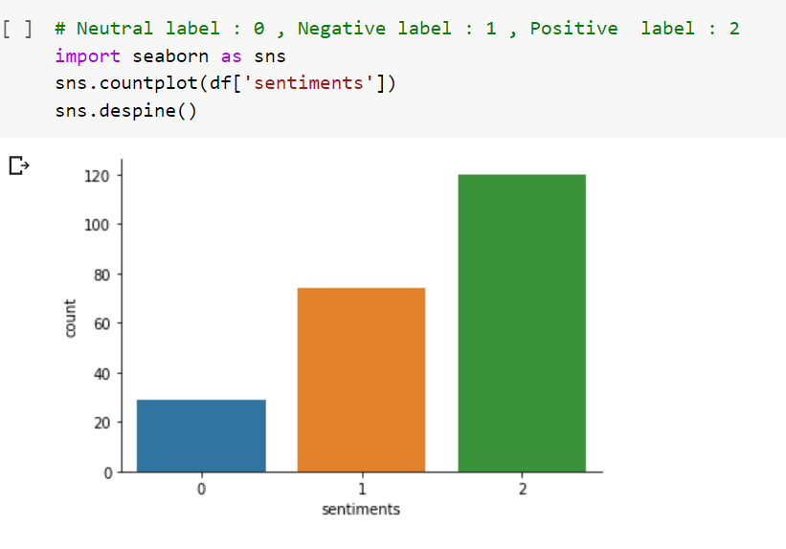
Splitting our dataset into Training and Validation Set

Slide 30
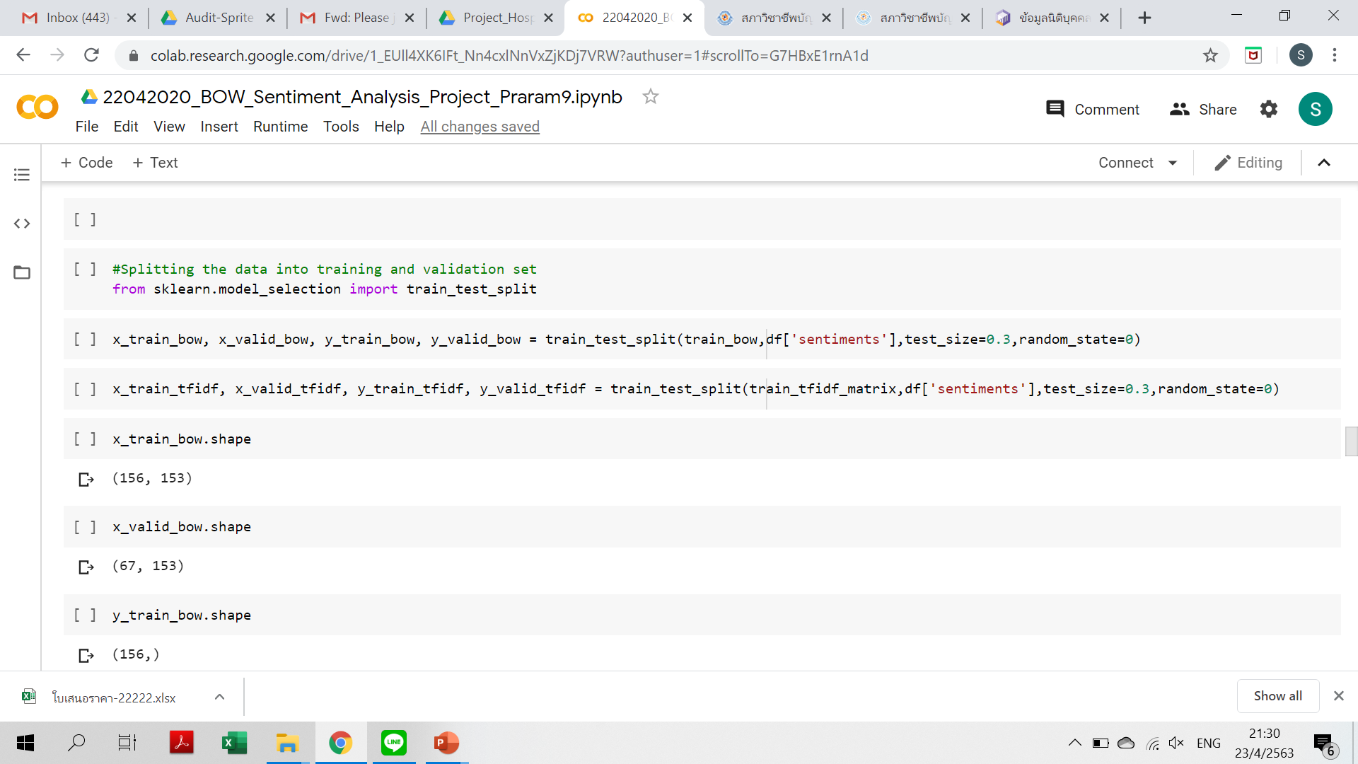

Splitting our dataset into Training and Validation Set

Slide 31
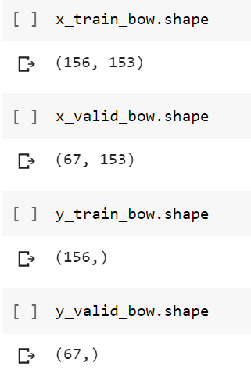
Splitting our dataset into Training and Validation Set

Slide 32
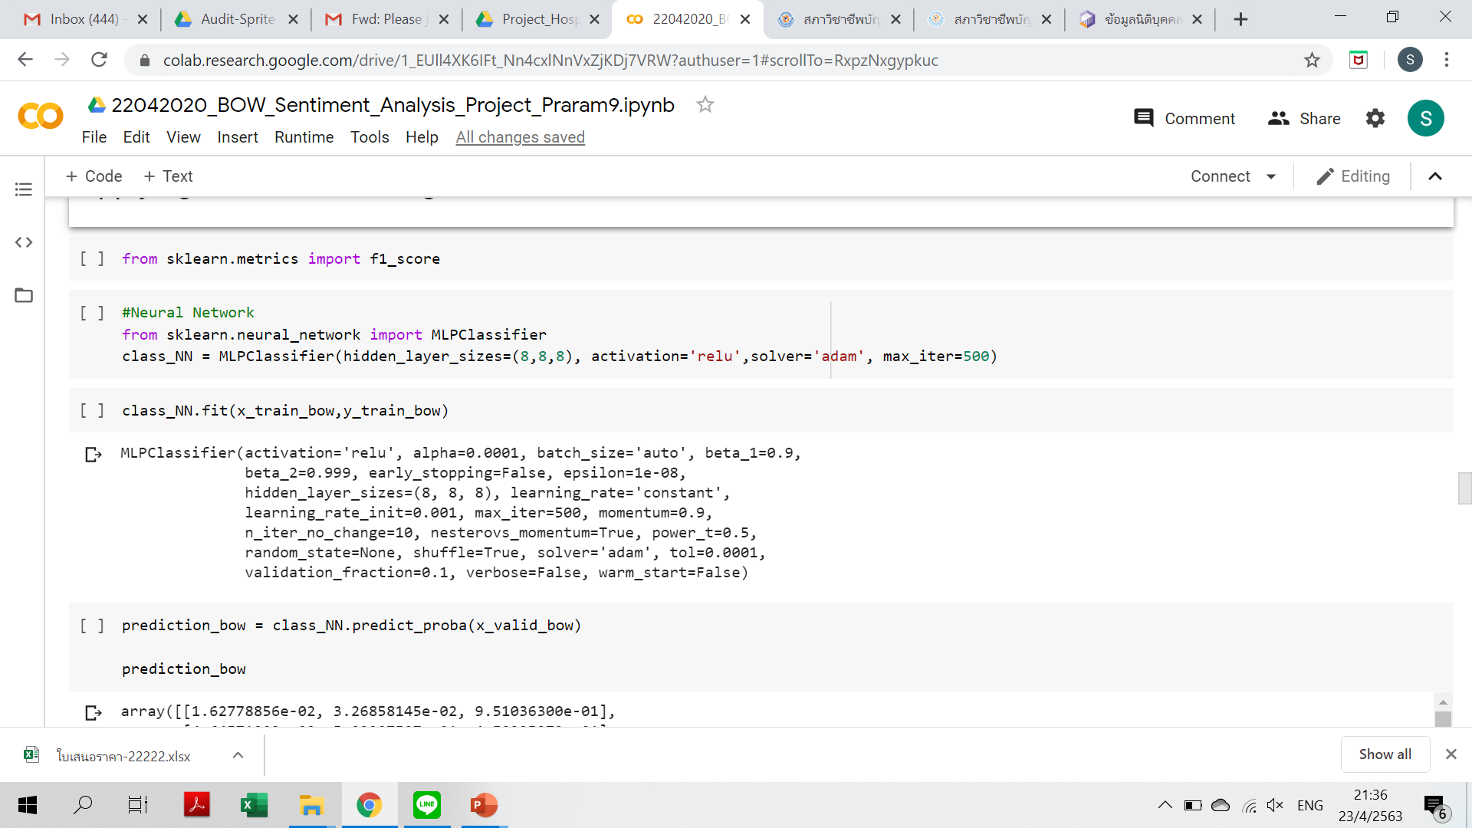
Applying Machine Learning Models

Slide 33
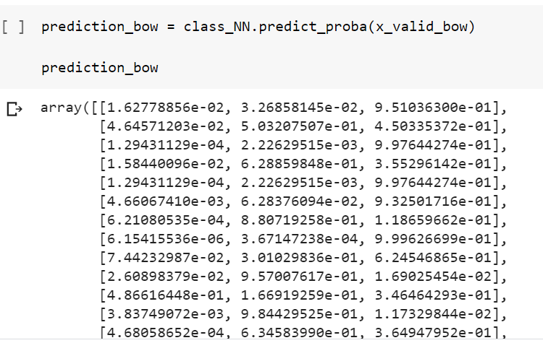
Applying Machine Learning Models

Slide 34
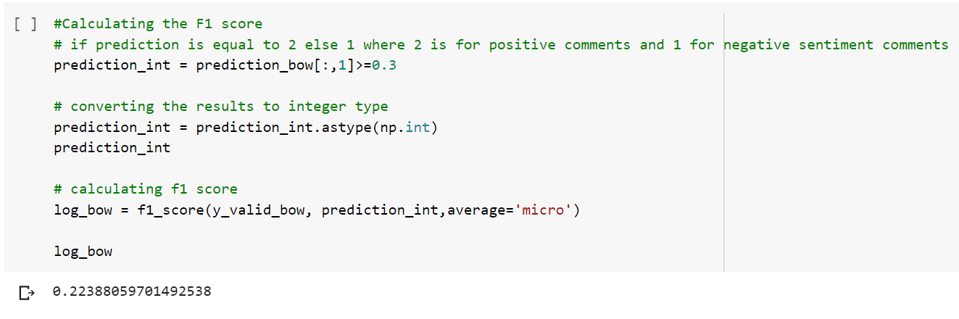
Applying Machine Learning Models

Slide 35
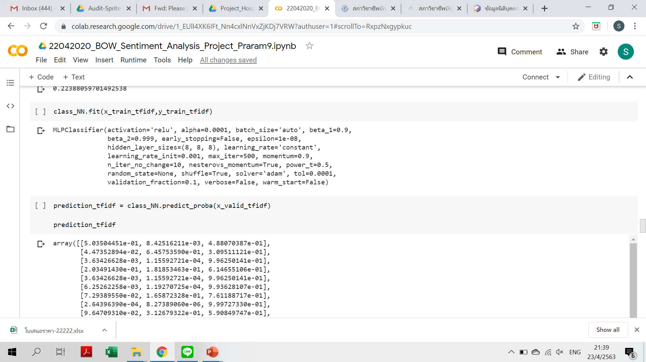
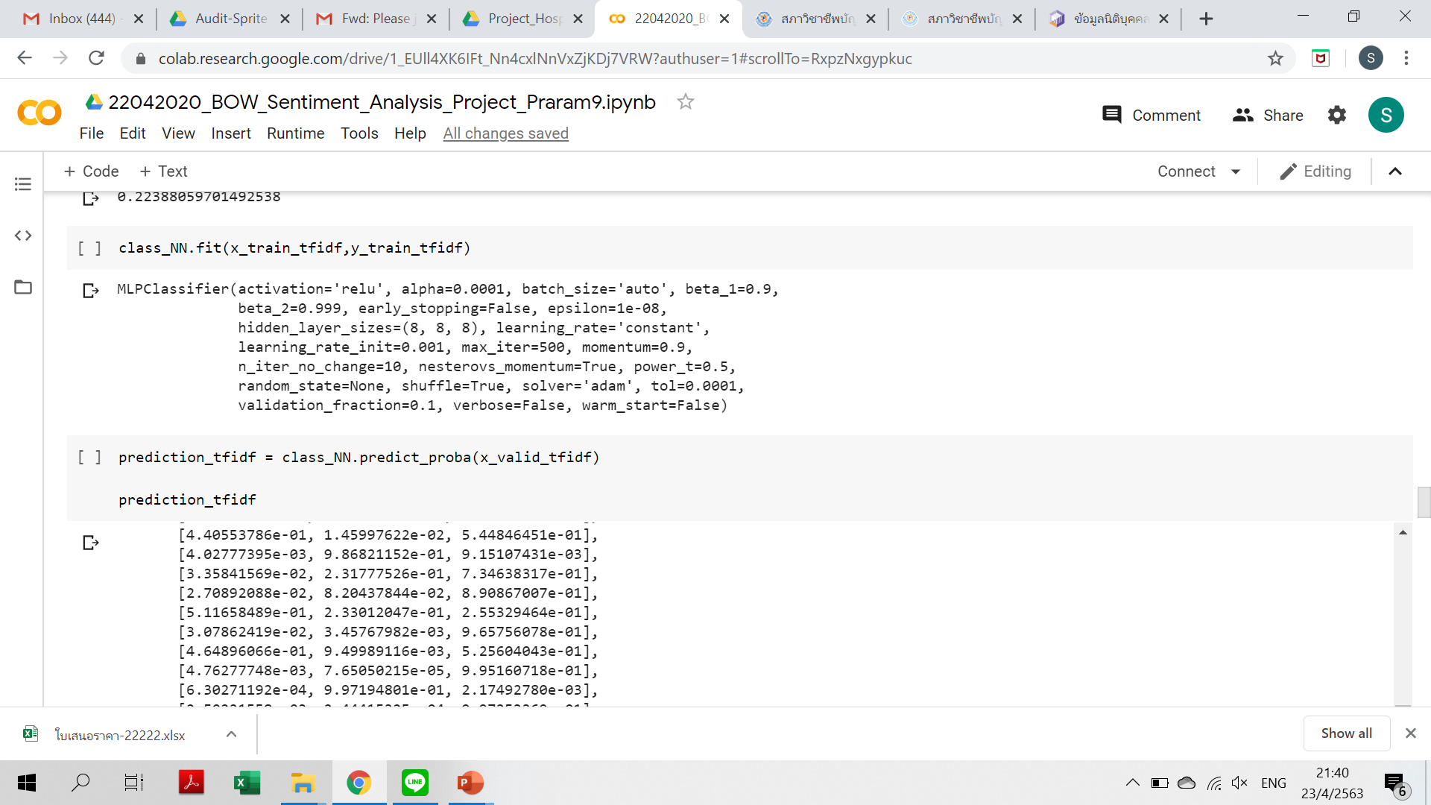
Applying Machine Learning Models

Slide 36
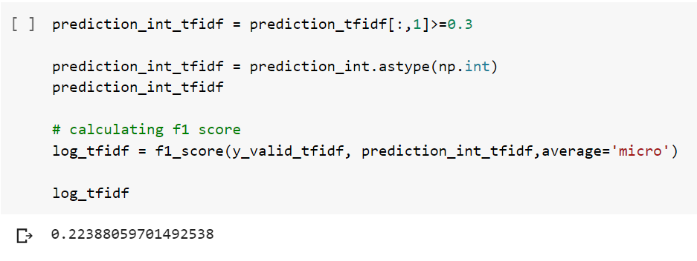
Applying Machine Learning Models

Slide 37
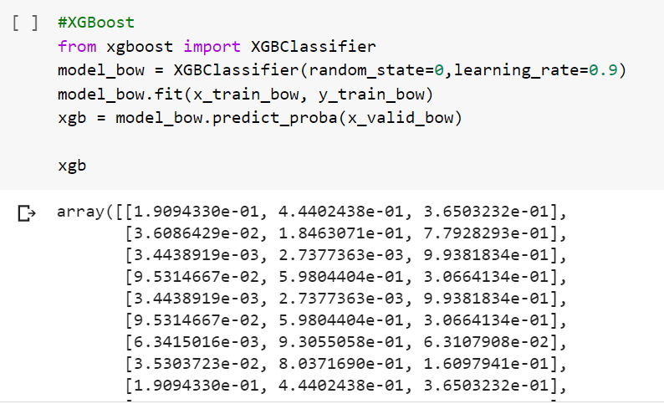
Applying Machine Learning Models

Slide 38
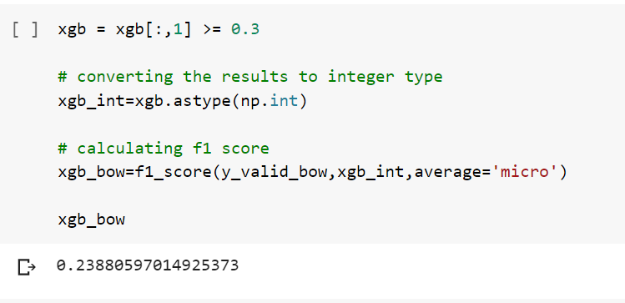
Applying Machine Learning Models

Slide 39
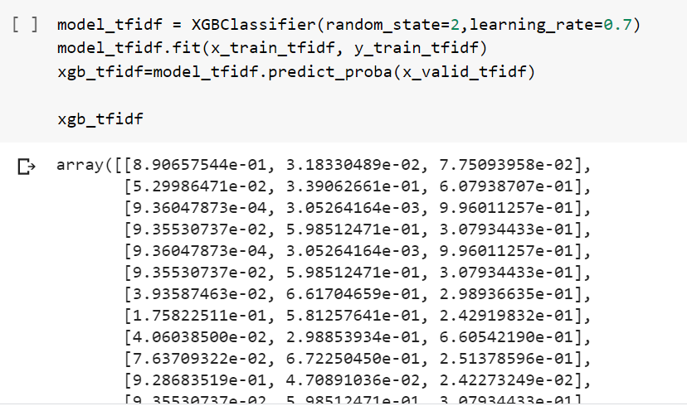
Applying Machine Learning Models

Slide 40
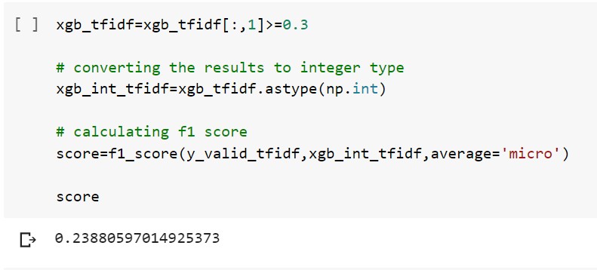
Applying Machine Learning Models

Slide 41
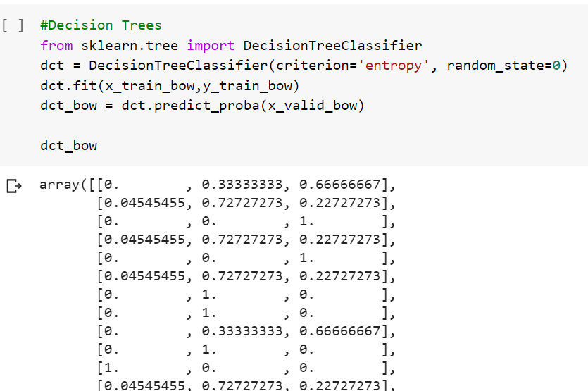
Applying Machine Learning Models

Slide 42

Applying Machine Learning Models

Slide 43

Applying Machine Learning Models

Slide 44

Applying Machine Learning Models

Slide 45

Model Comparison

Slide 46

Model Comparison

Slide 47


Evaluating the model

Slide 48

Evaluating the model

Slide 49


Comparison Graph

Slide 50


Comparison Graph

Slide 51


Playing around with auto-sklearn

Slide 52


Playing around with auto-sklearn

Slide 53


Playing around with auto-sklearn

Slide 54


Playing around with auto-sklearn

